Slide 1
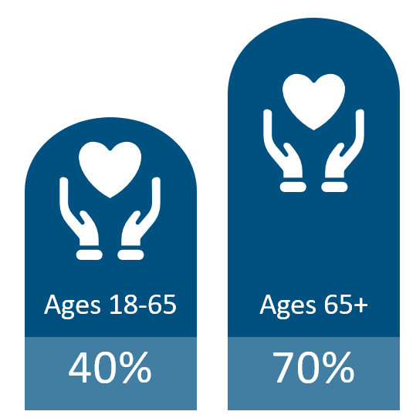
Long Term Care Insurance
Likelihood of Requiring LTC¹
Average Cost of Care²
Home Care
Assisted Living
Nursing Home
$77,792
Avg Stay 3 years
$70,800
Avg. Stay 2.5 years
$127,750
Avg. Stay 2.4 years
Benefits That Cover Long Term Care
LTC Financing Crisis
56% of couples without LTC insurance spend their income down to poverty level after one partner has spent six months in a nursing home³ Medicaid now consumes 30% of state budgets Medicaid pays for about 45% of total LTC service and support costs⁴
¹ASPE.HHS.gov, 2019 ²Genworth 2024 Cost of Care ³ Health Insurance Association of America ⁴ Long-Term Services and Supports: History of Federal Policies and Programs, Congressional Research Service, December 2023.

Slide 2
Why Employers Offer LTC Insurance
LTC INSURANCE
EMPLOYERS OFFERING LTC BENEFITS
Only benefit that pays for LTC
KFF – 25% of employers offering health insurance also offer LTC insurance. Of those, 39% contribute toward the cost of the plan through employer funding
401k/403b PRESERVATION
Employees pay for LTC from investments
EMPLOYER FUNDING
Funded for All or Defined Class – years of service, title, salary
Attract & Retain – with Differentiating Benefit
401k/403b Preservation – employees that max out benefit
Employee Engagement – increases 600%
LTC LEGISLATION - LINK
Medicaid consumes 30% of state budgets so state are evaluating options to reduce Medicaid cost.
EMPLOYEES REQUESTING LTC
2021 LIMRA Study - top 3 reasons for Life + LTC products:
Concern LTC costs may deplete or exceed savings – 35%
It is a more economical use of current assets – 33%
Benefits pay even if LTC expenses aren’t incurred – 29%
NY Life Study
LTC is one of top 5 benefits employees are most interested in
GROUP PLAN ADVANTAGES
Portable – at same rate
Issue Age Rates – do not increase with age.
Guaranteed Issue – exclusive to employer plans. Provides employees access to a benefit.

Slide 3
Off-Cycle Enrollment
600% participation increase compared to on-cycle
Client Decision | May | June | July | August
Enrollment Month | July | August | September | October
Effective Date first of Month | September | October | November | December
New York Life

